Slide 1


Capstone Project: Interim Presentation (Group 6)
DOMAIN– INSURANCE
TOPIC- Leveraging data analytics for car insurance claim prediction
Group Members :
Adishree Patra
Chandan Deep V
Madhu. S
Mohammad Khaja Pasha
Pavan Kalyan V

Slide 2


Using historical data, develop a predictive model to identify short duration claims of car insurance customers. Additionally, enhance the classifier to segregate customers(high risk) efficiently.
PROBLEM STATEMENT

Slide 3
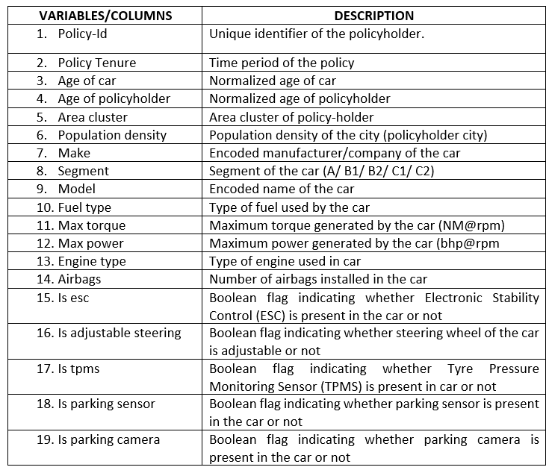
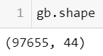
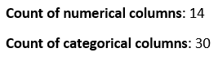
DATA DICTIONARY:
Data Description - The dataset contains information about the policyholder and the car they own. Based on them the target variable is one which tells whether the policyholder has claimed insurance within six months or not.

Slide 4
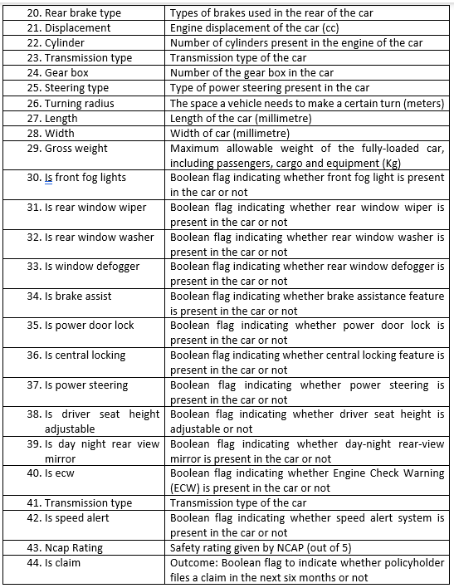

Slide 5
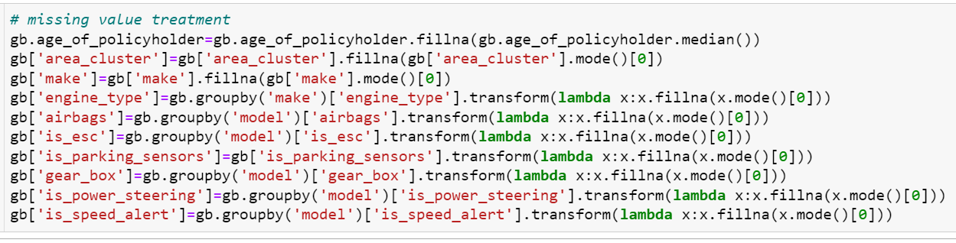
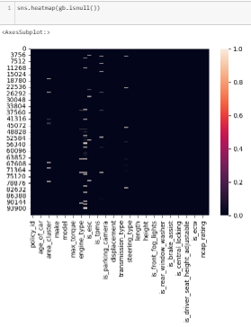
Data Pre-Processing
Missing/Null values:
• Total count of missing values- 17,978
• Columns containing missing values- age_of_policyholder(61), area_cluster(816), make(1), engine_type(898), airbags(8225), is_esc(1997), is_parking_sensors (3508), gear_box (2085), is_power_steering (194), is_speed_alert (193)
Missing value treatment:

Slide 6
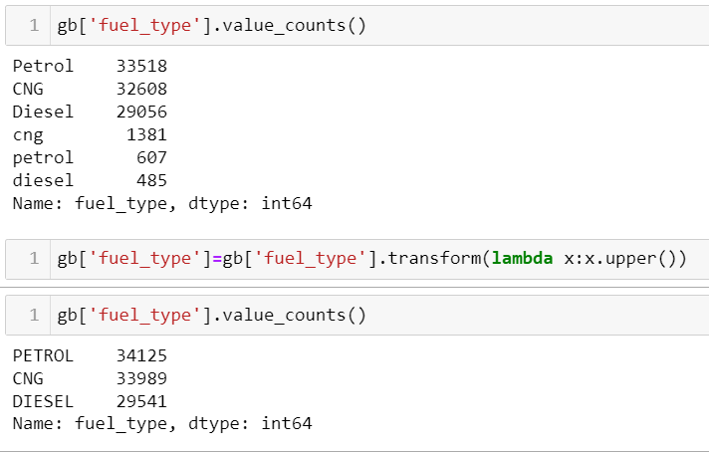
2. Variable ‘fuel_type’ has three subclasses, Petrol, CNG, Diesel which was counted as six because of its entry in different cases. This has been corrected

Slide 7
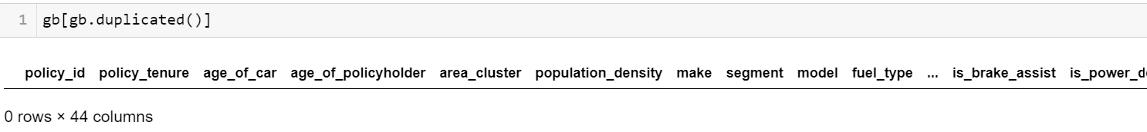
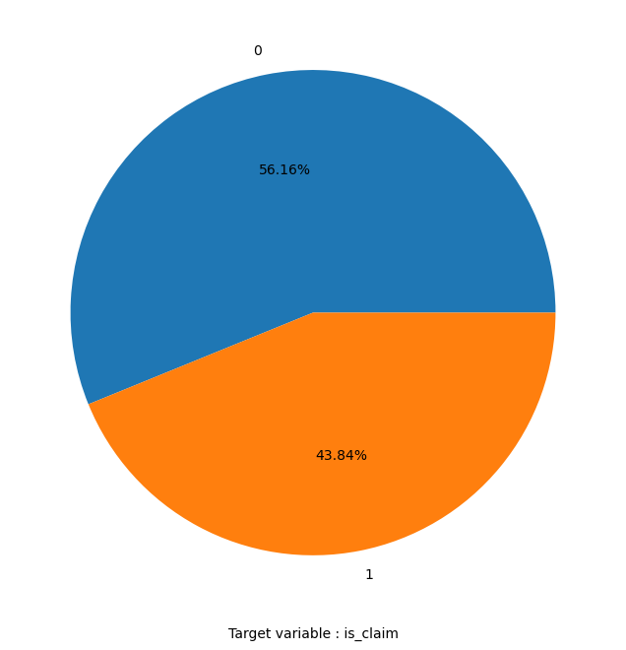
3. Duplicate records: No duplicate rows found
4. Class Imbalance: In the given dataset the two subclasses of target variable has a distribution of 56.1% (class 0) and 43.8% (class 1). The class is fairly balanced.

Slide 8
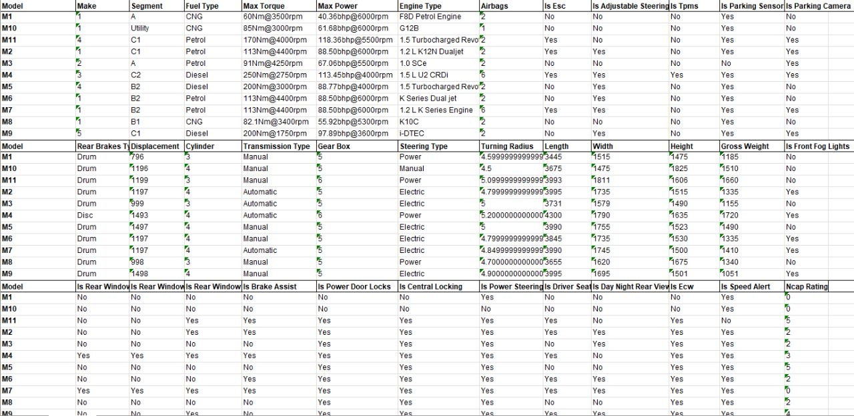
5. Redundant Columns : ‘Policy_id’ being a unique identifier is a redundant column. The dataset contains a lot of other redundant columns which are identified and dropped.

Slide 9
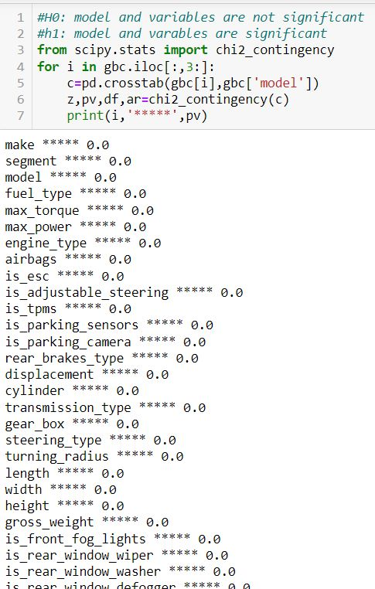
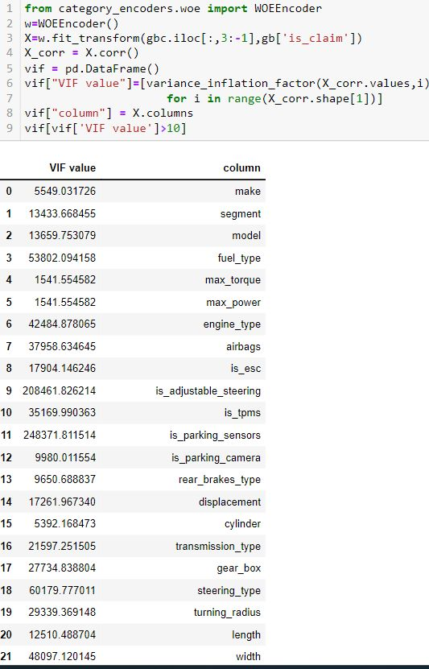
Chi-square test
VIF

Slide 10
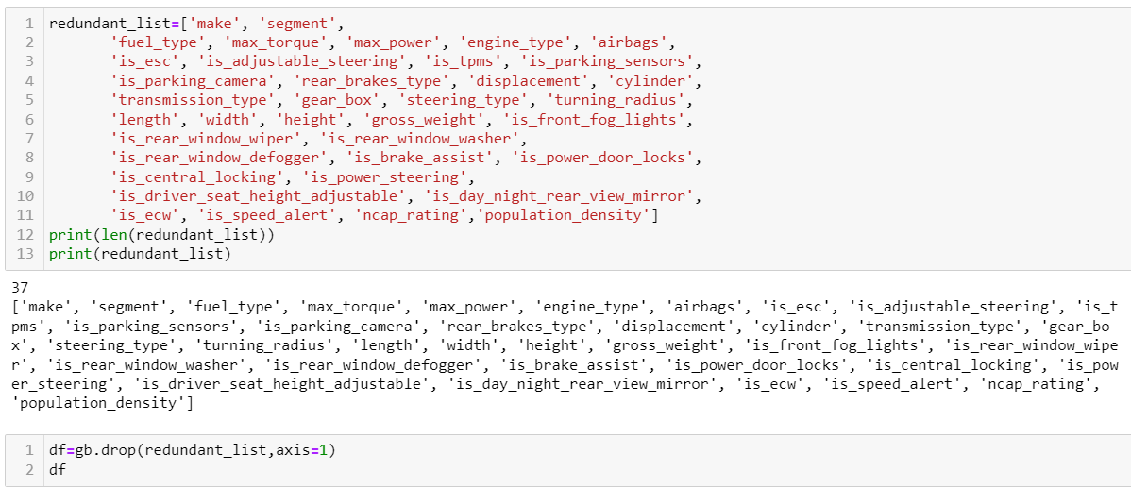
Dropping Redundant columns:

Slide 11
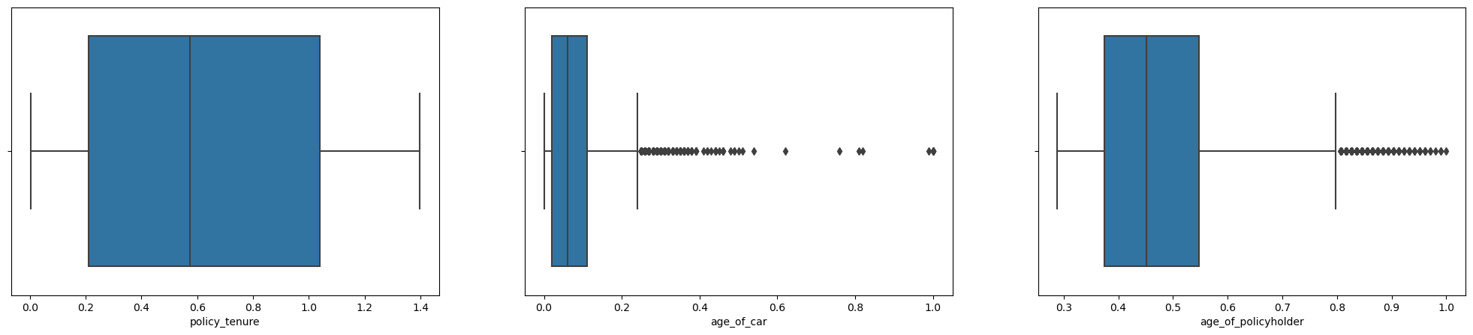
6. Outlier visualization through Boxplots:
‘age_of _car’ and ‘age_of_policyholder’ have outliers. The outliers can be treated in many ways such as dropping, binning, capping, or doing separate analysis on them.

Slide 12
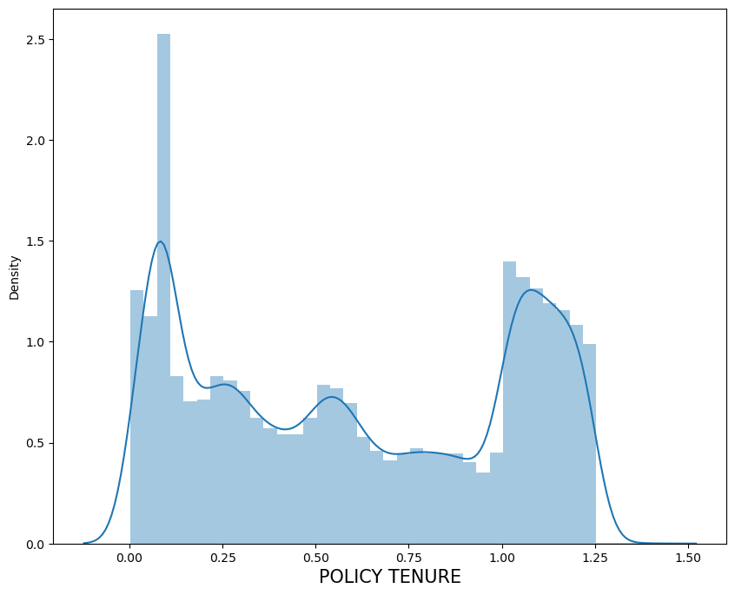
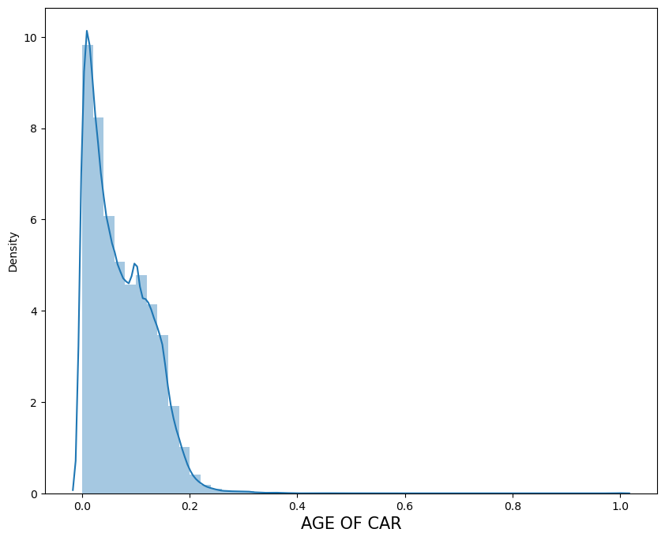
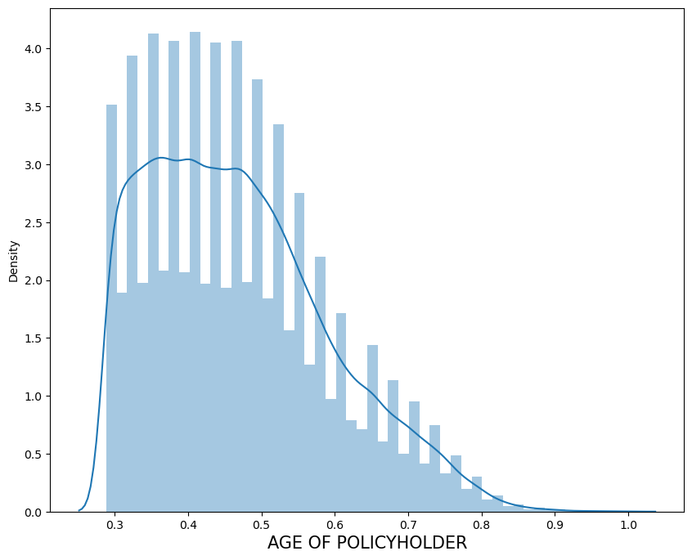
7. UNIVARIATE ANALYSIS :
1. Numerical variables

Slide 13
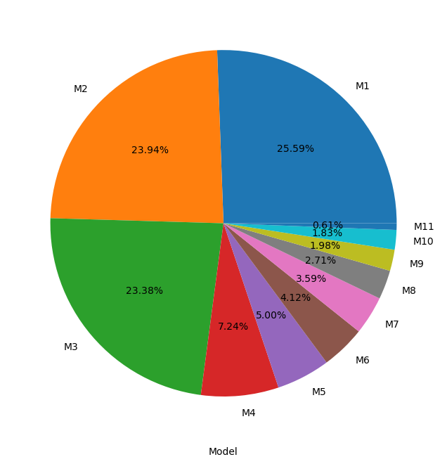
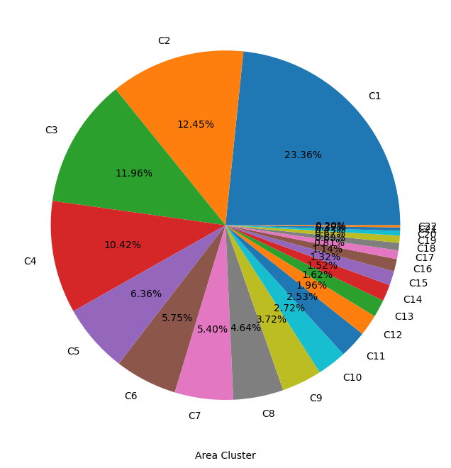
UNIVARIATE ANALYSIS:
2. Categorical Variables

Slide 14
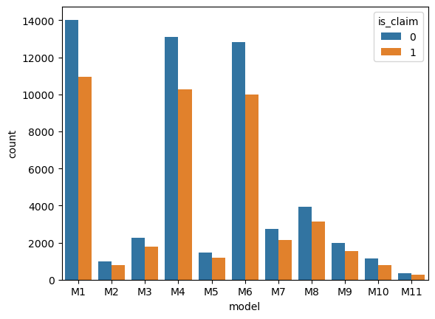
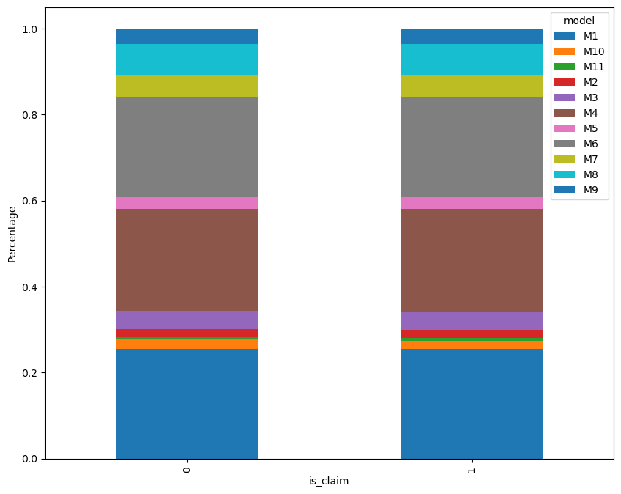
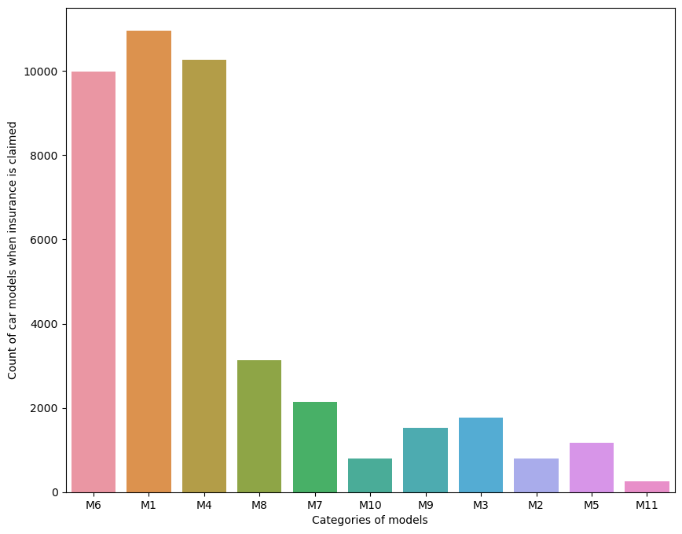
8. BIVARIATE ANALYSIS
a. Model v/s Is_claim

Slide 15
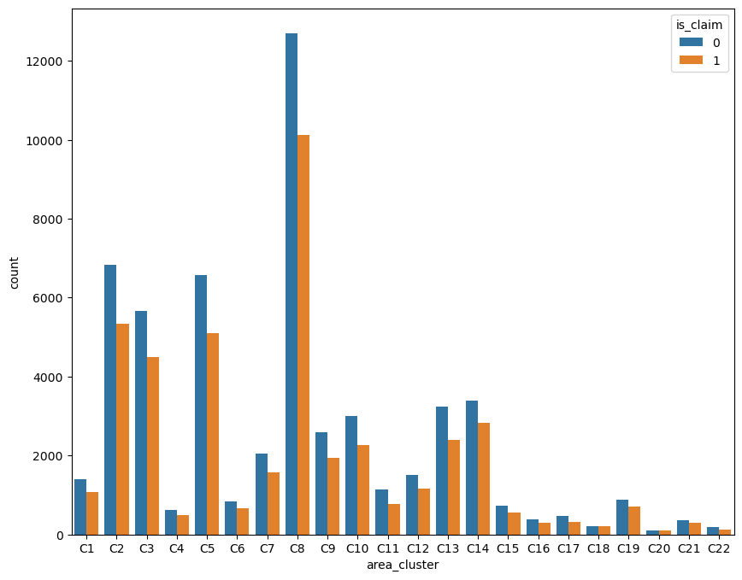
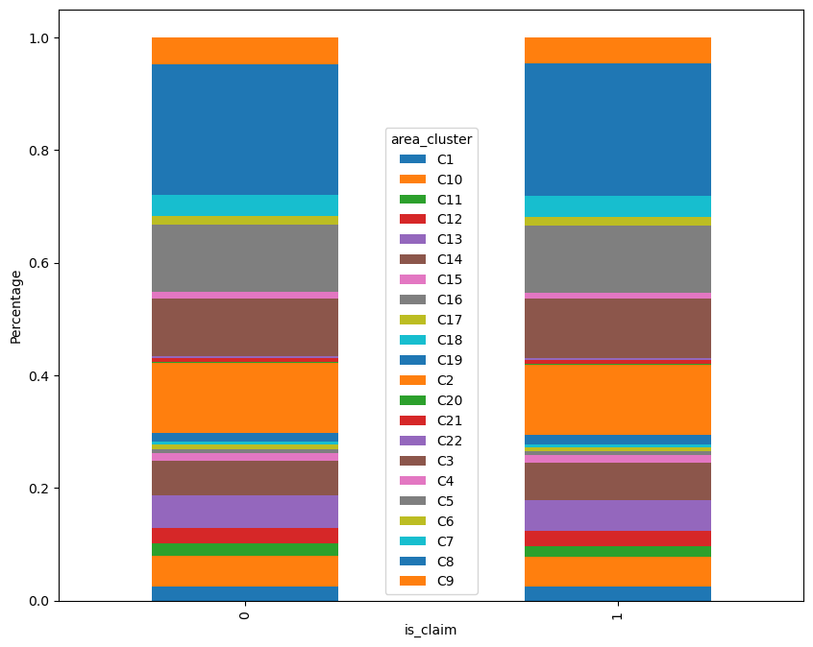
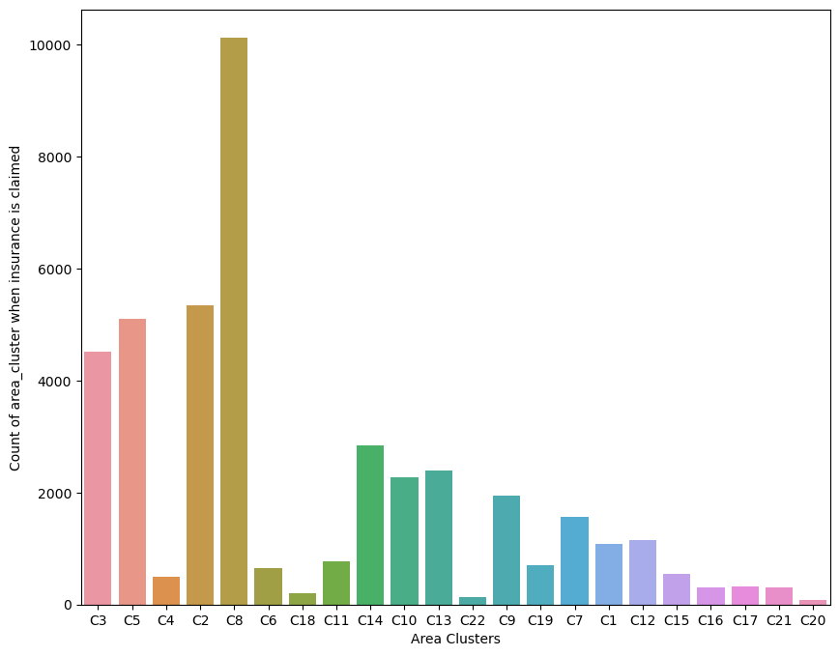
BIVARIATE ANALYSIS:
b. Area cluster v/s Is_claim

Slide 16
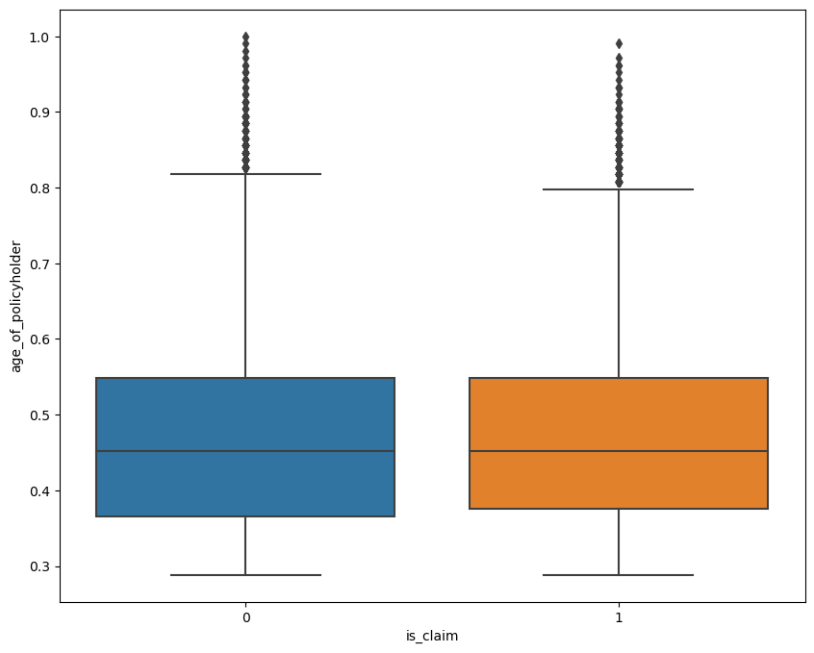
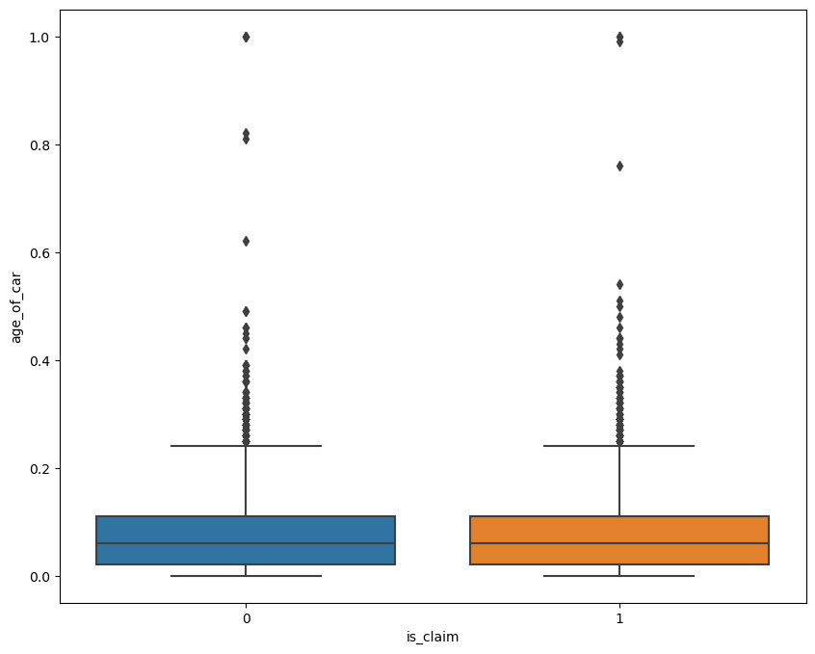
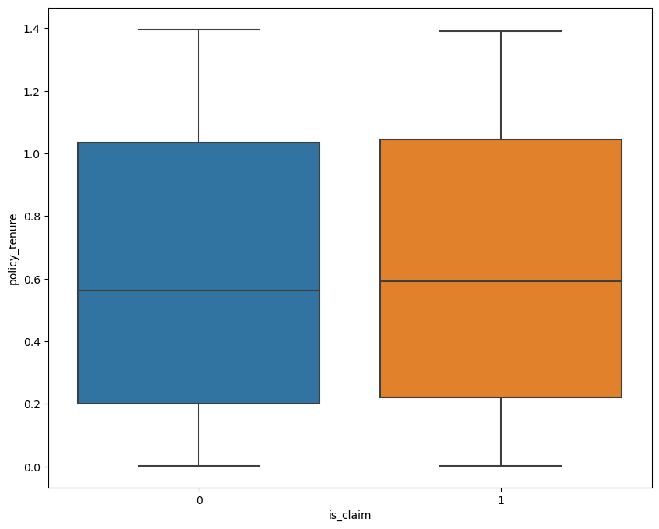
BIVARIATE ANALYSIS:
c. NUMERICAL VARIABLES V/S TARGET VARIABLE

Slide 17
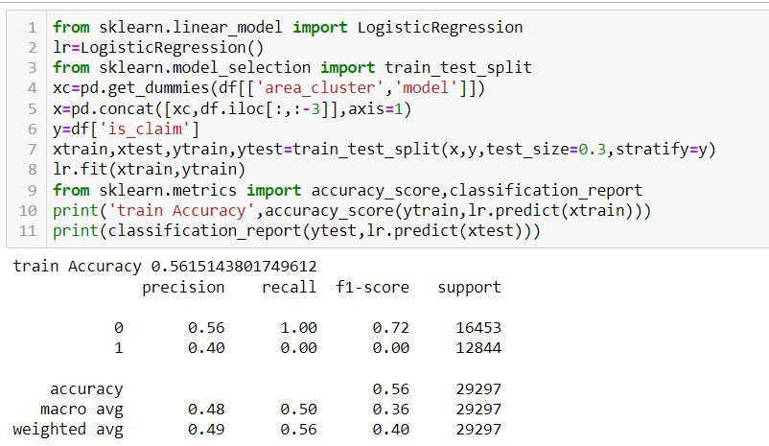
9. FEATURE ENGINEERING:
Scaling and Transformation- In the original dataset numerical columns- policy_tenure, age_of_car, age_of_policyholder have been normalized using min_max_scaler.
Since the numerical columns ‘age_of_car’, ‘policy_tenure’, ‘age_of_policyholder’ has skewness in it, transformation is required. On the columns ‘age_of_car’ and ‘policy_tenure’ yeo-johnson transformation is applied and on age_of_policyholder’ box-cox transformation is applied.
10. BASE MODEL:
In this this project, a base model is fitted using Logistic Regression algorithm with its default parameters. Logistic Regression model is chosen as a base model since the target variable ‘is_claim’ is a binary classification and after reducing redundant columns, the dataset has three numerical and two categorical columns. The accuracy from base model turns out to be 56.16%.

Slide 18
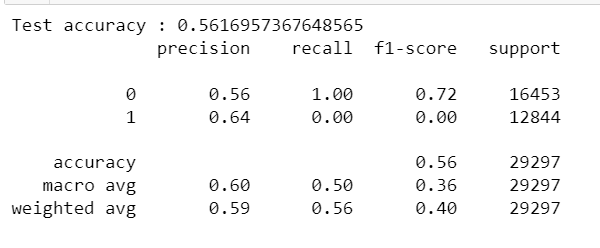
Inference from base model and Details about further work:
After understanding and performing exploratory data analysis, a base model is fitted using logistic regression. The base model is giving 56.15% accuracy on train data and 56.16% accuracy on test data. From this it can be concluded that this base model is not in overfit condition.
To improve the predictive model further, several steps can be taken such as applying grid-search cv, cross validation, gradient descent, using other algorithms(DT, KNN, NB), tuning hyper parameters, ensembling techniques(bagging/boosting).
The final model would be one that achieves highest accuracy for the given dataset.

Slide 19


